Slide 1
The
Program
Notes:
Let me introduce myself. I am a client of the program as well as an employee. If not for the advice of a dedicated social worker I may not be working here today. After my family member was released to a nursing home the social worker helped me to navigate through all the funding resources available. I have almost 11 years here at VHC

Slide 2
Our
History
2003 - Bonnie Laiderman was the caregiver for her Mom
Discovered how difficult and complex it is to access the VA funds, but knew it could cover the care her Mom needed
Started a company to help veterans and surviving spouses successfully obtain the
“Aid & Attendance VA Benefit”.
20 Years – helping over 20,000+ Veterans
Notes:
Bonnie’s promise to Edie – I will never let this happen to another Veteran or Surviving Spouse. I will start a company to help people just like us.

Slide 3
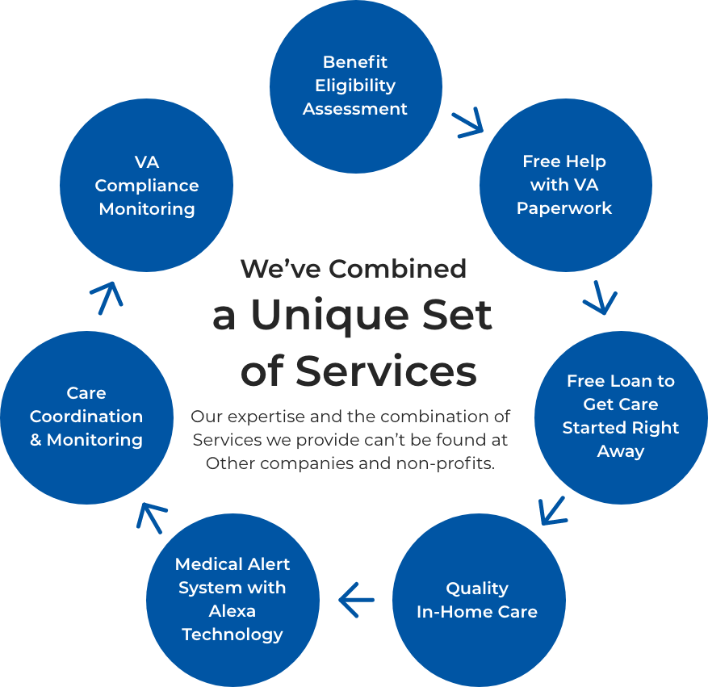
The VetAssist
Program
Difference
Notes:
If this process was easy, we wouldn’t have a business today. We would not have over 4,000 home care agencies, 2600 clients and another 2,000 healthcare professionals reaching out to refer to us. We do not charge the Vetern for our service We do however negotiate a fair market rate with our agency partners to cover the cost of services we provide. Included in our program we now have a 24/7 emergency medical device a case manager is assigned to communicate with the families and a team to ensure the client remains in compliance with the program

Slide 4
Program
Specialists
Your patients will be sent to a qualified team of professionals standing by to take their call!
Determine eligibility for the VetAssist Program® using our exclusive Lead Tool
You have come to the right place …
If not eligible – suggest other resources
We can simplify a complex program …
If eligible – the lead tool will capture the information as a qualified lead
We thank you for your service to our country ...

Slide 5
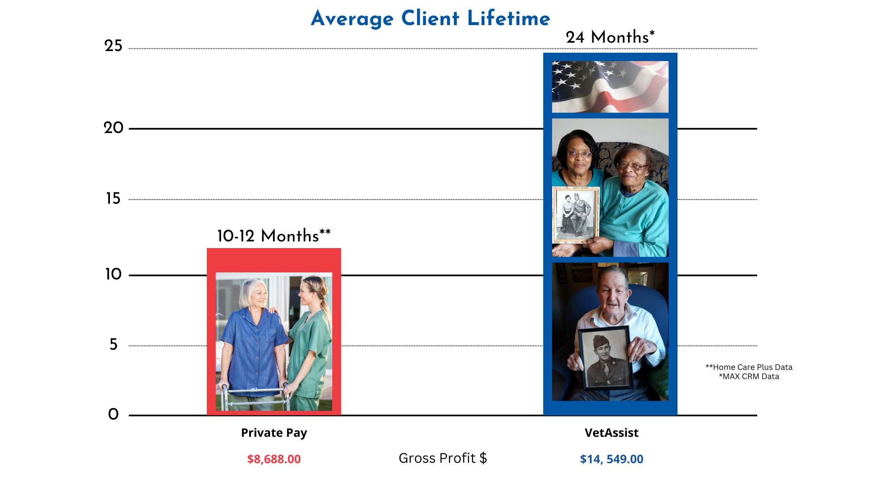
The VetAssist Client Retention
(2 years)*

Slide 6
How to Identify a Referral for the VetAssist Program

Slide 7
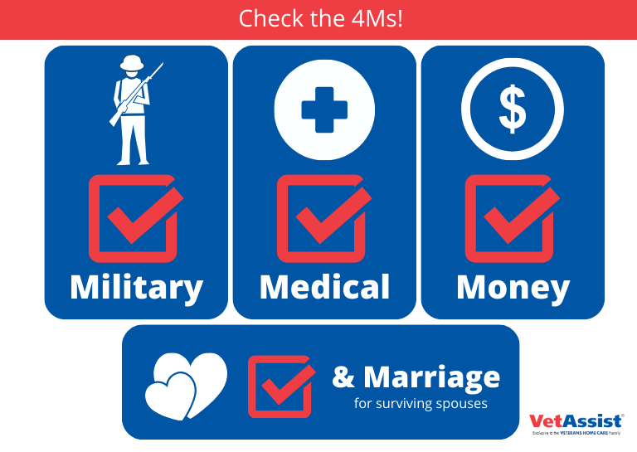
Who Is
Eligible

Slide 8
3 Easy Steps
ASK THESE QUESTIONS DURING INTAKE...
1. Is the client a Veteran of wartime?
World War II
Korean War
Vietnam
Gulf War
2. Was the client married to someone who served during wartime? (surviving spouse)
3. Does the client need home care to remain home safely and with dignity?
If yes, send the referral to Veterans Home Care

Slide 10
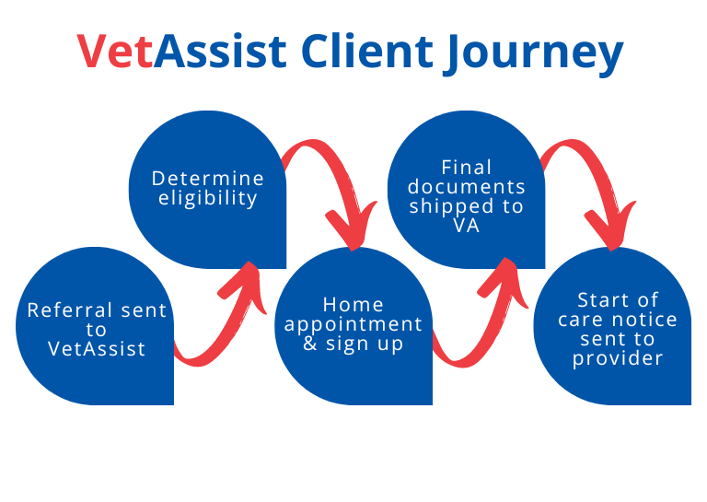
Final documents sent to VA
Determine eligibility
Referral sent to VetAssist
Start of care notice sent to provider
Home appointment & sign up

Slide 11
Why Partner
With Us?
Ease of billing
Increase dollars billed – 15% of our clients need additional hours
Increase billable clients
Longer average length of stay
Hours that don’t expire
Stand alone program for marketers to get in more doors
Sense of community assisting our nation’s veterans and their families

Slide 12
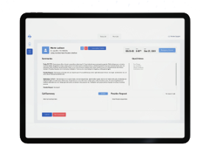
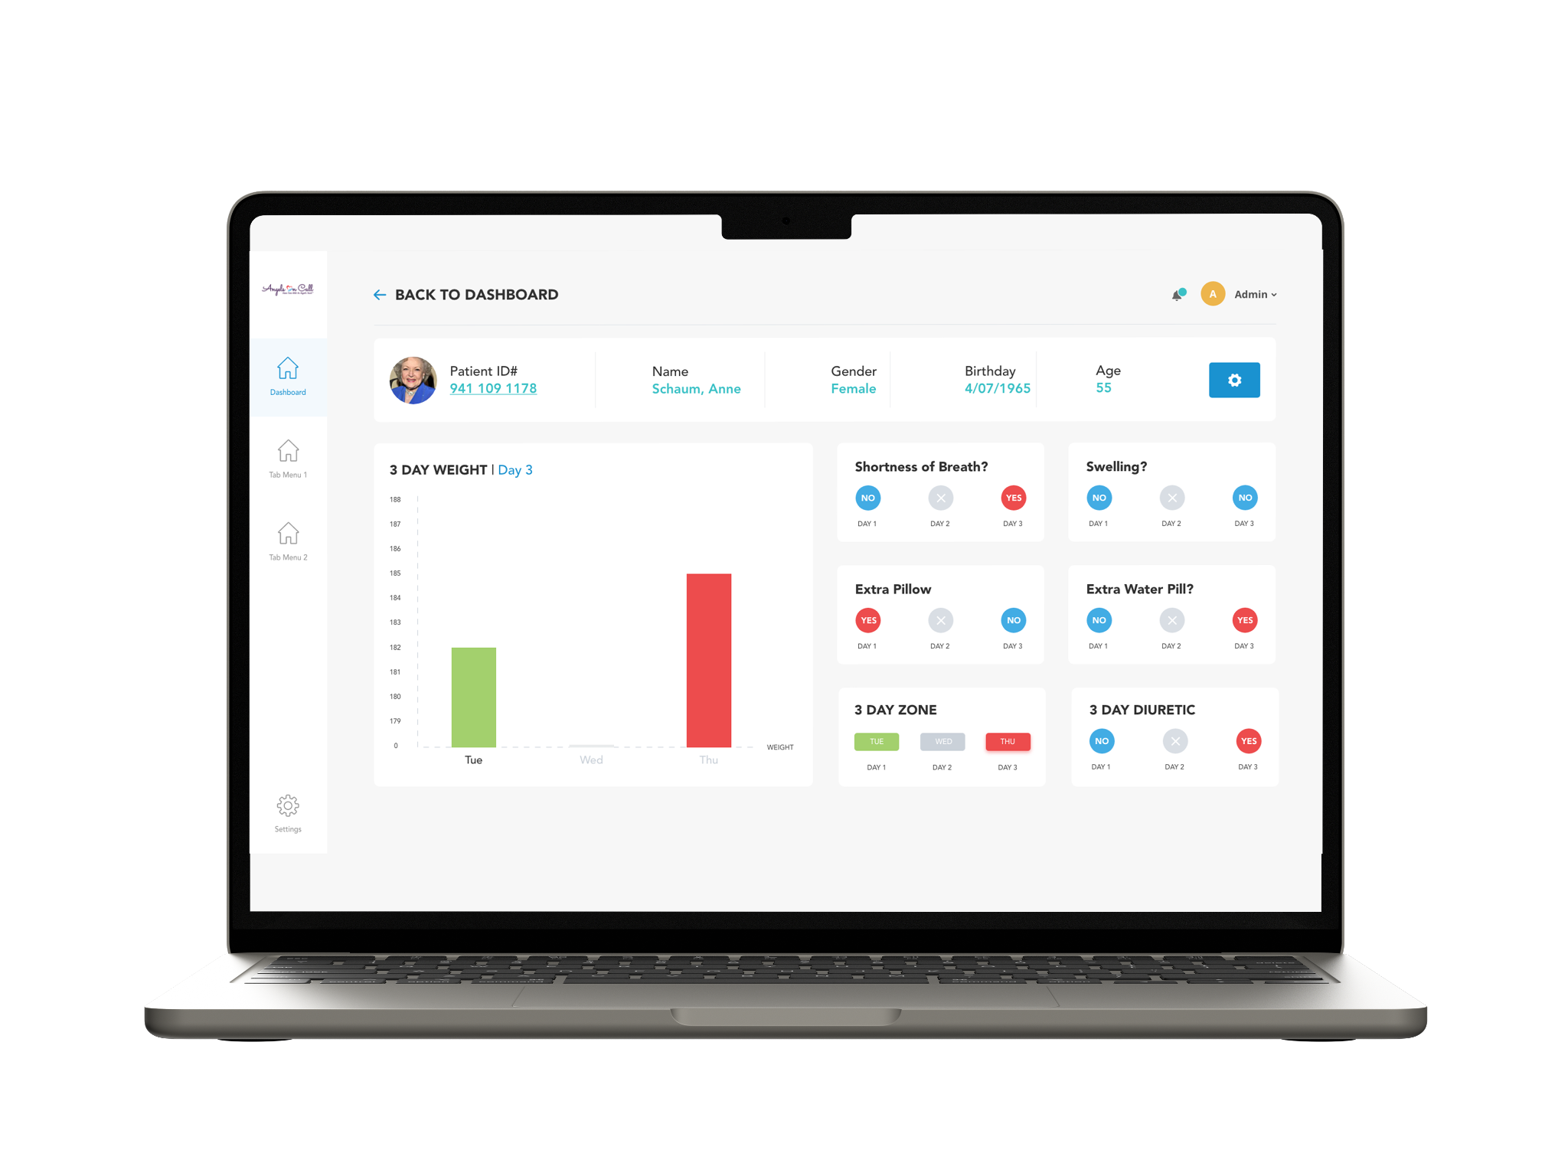
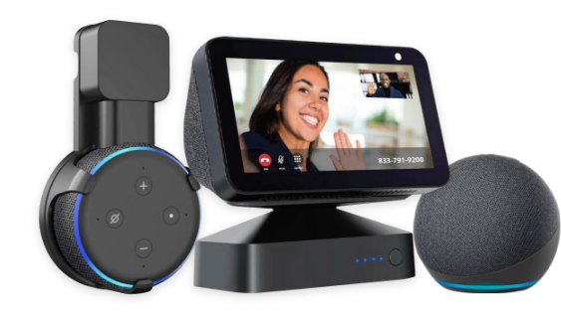
Enhanced Care Services
Included in the VetAssist Program
The “Hub”
A personalized,
whole-home system of smart medical alert devices with the intelligence and entertainment of Alexa®.
Scheduled calls by our compassionate healthcare professionals team offer a reliable point of contact for expressing feelings, health needs, and non-health concerns.
The VoiceHealth skill, accessed through the VetAssist Companion, allows a healthcare professional to monitor daily care routines and wellness indicators.

Slide 13
Tools

Slide 14
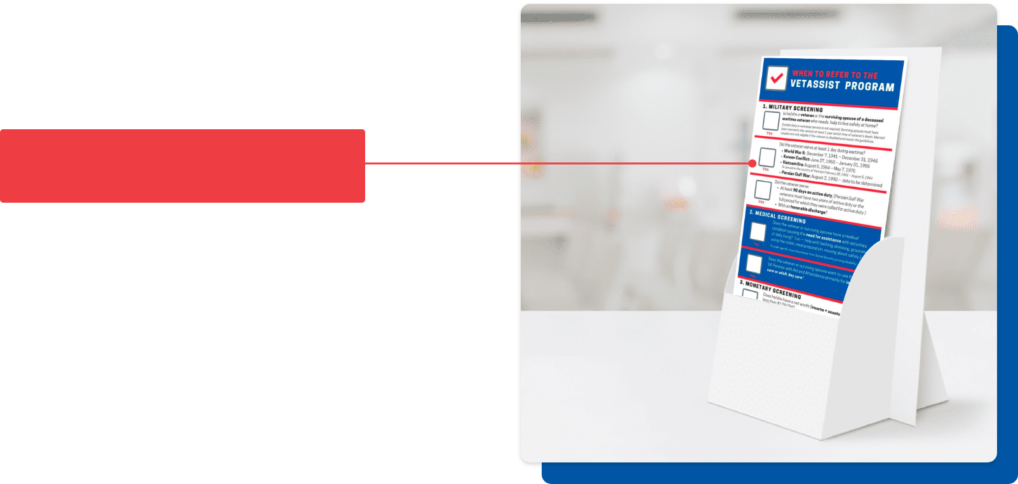
VetAssist Rack Card
Wartime Dates

Slide 15
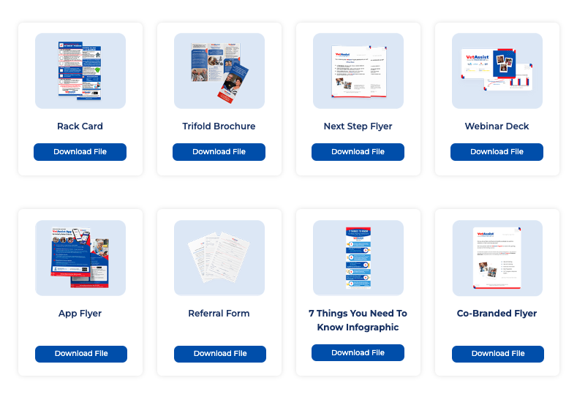
VetAssist Program brand assets at your fingertips!

Slide 16
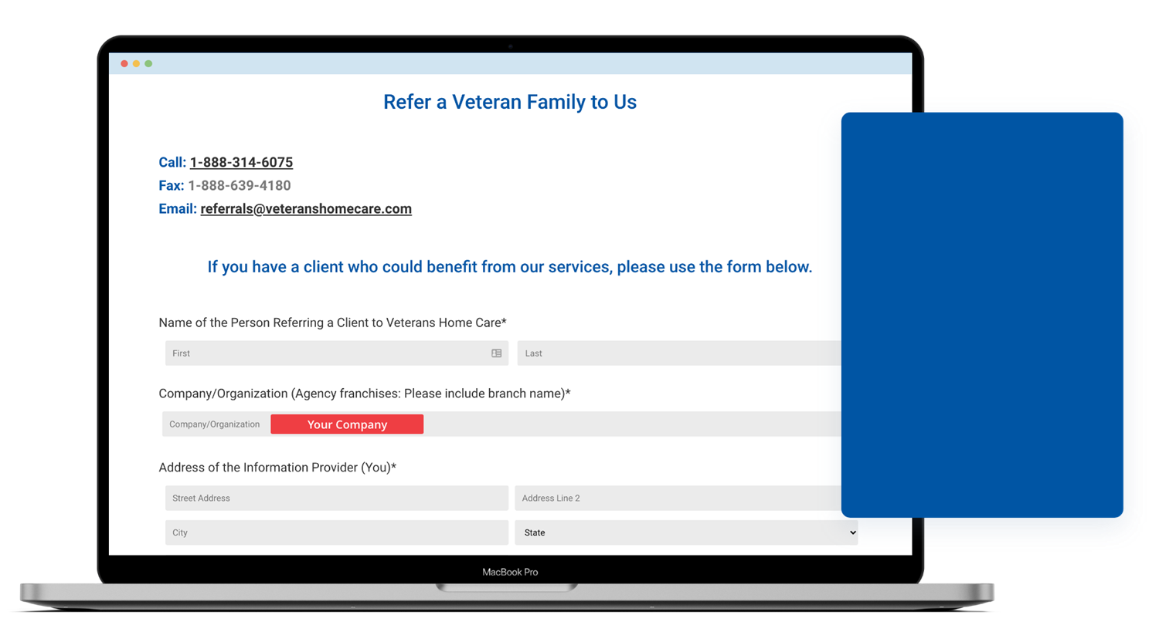
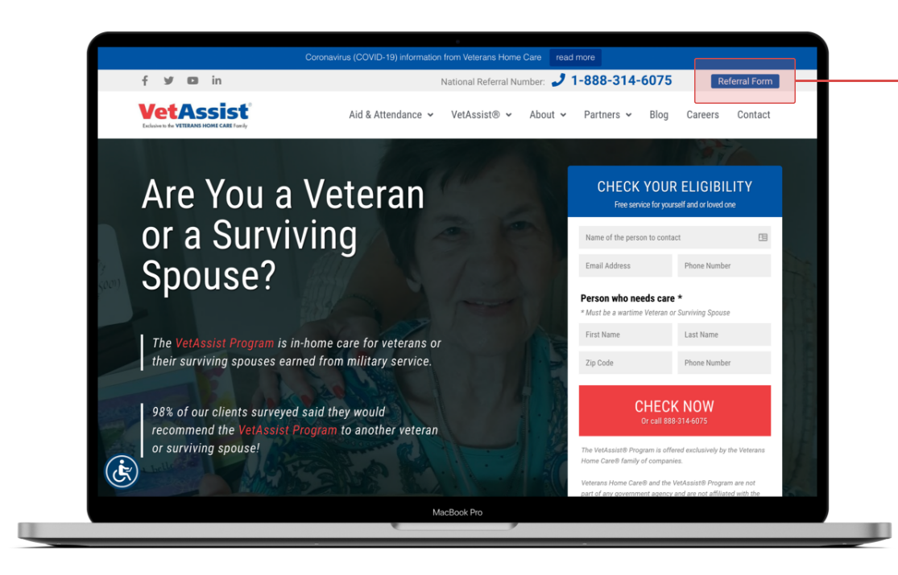
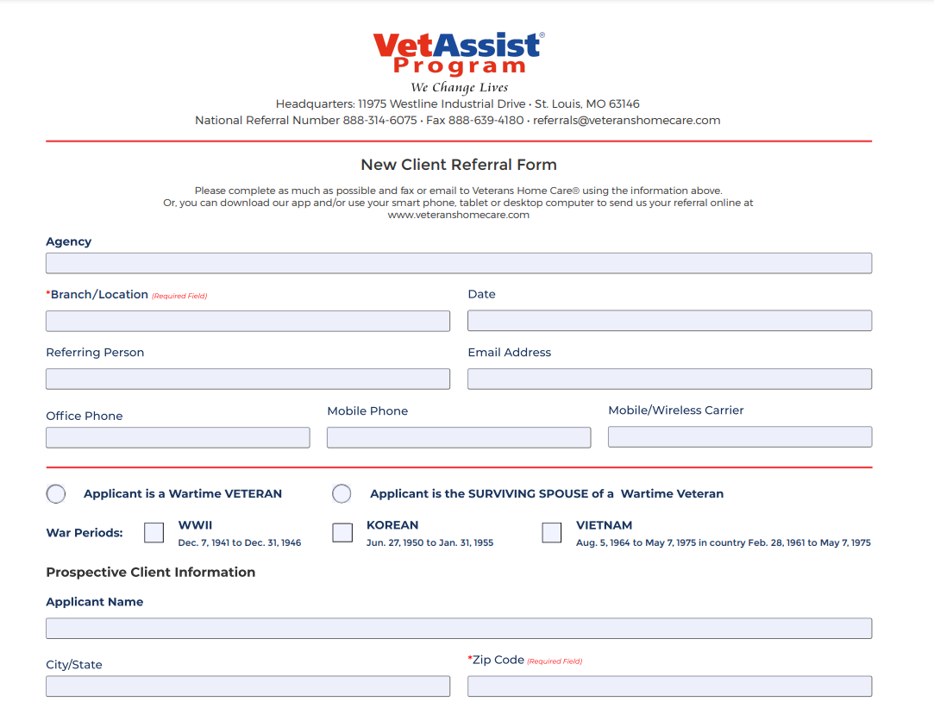
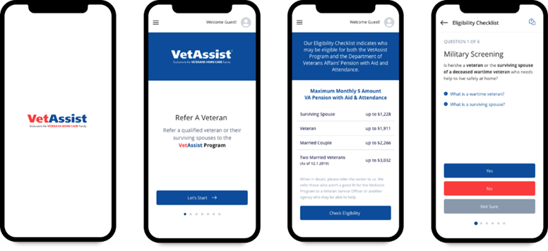
Multiple Options to Make Sending Referrals Easy
Online Form
www.veteranshomecare.com
Download Fillable PDF Form
to email or fax
Be sure to put
the branch
VetAssist App
to Quickly Check Eligibility and Refer
Veterans in Need!

Slide 17
Questions?

