Slide 1
The VetAssist Program
Notes:
Let me introduce myself. I am a client of the program as well as an employee. If not for the advice of a dedicated social worker I may not be working here today. After my family member was released to a nursing home the social worker helped me to navigate through all the funding resources available. I have almost 11 years here at VHC

Slide 2
Our
History
2003 - Bonnie Laiderman was the caregiver for her Mom
Discovered how difficult and complex it is to access the VA funds, but knew it could cover the care her Mom needed
Started a company to help veterans and surviving spouses successfully obtain the
“Aid & Attendance VA Benefit”.
20 Years – helping over 20,000+ Veterans
Notes:
Bonnie’s promise to Edie – I will never let this happen to another Veteran or Surviving Spouse. I will start a company to help people just like us.

Slide 3
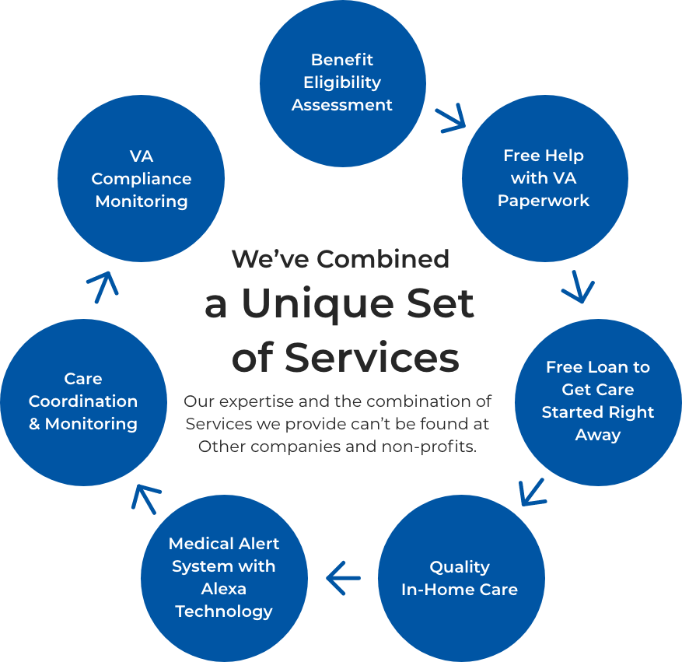
The VetAssist
Program
Difference
Notes:
If this process was easy, we wouldn’t have a business today. We would not have over 4,000 home care agencies, 2600 clients and another 2,000 healthcare professionals reaching out to refer to us. We do not charge the Vetern for our service We do however negotiate a fair market rate with our agency partners to cover the cost of services we provide. Included in our program we now have a 24/7 emergency medical device a case manager is assigned to communicate with the families and a team to ensure the client remains in compliance with the program

Slide 4
How to Identify a Referral for the VetAssist Program

Slide 5
Enrollment Center – 40,000 Leads per year
Your patients will be sent to a qualified team of professionals standing by to take their call!
$2,229
$2,643
$1,432
Notes:
A couple $28,000 – 3 M’s

Slide 6
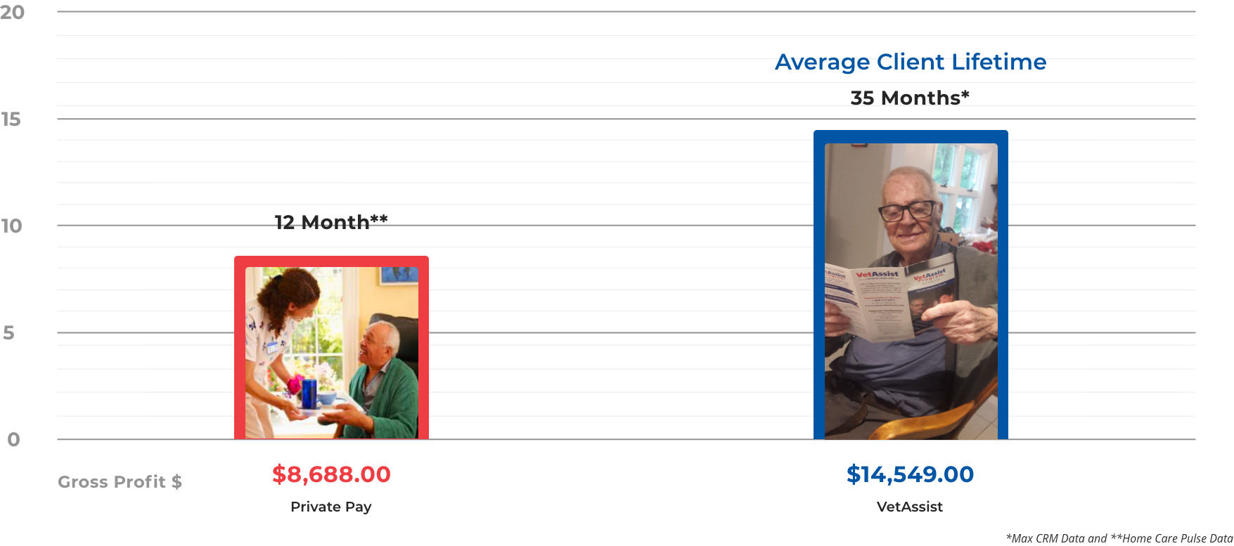
The VetAssist Client Retention
(Nearly 3 years)*

Slide 7
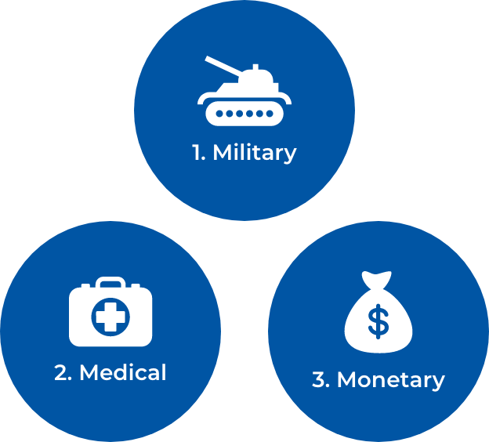
Who Is
Eligible
Ask about the 3 M’s

Slide 8
3 Easy Steps
ASK THESE QUESTIONS DURING INTAKE...
1. Is the client a Veteran of wartime?
World War II
Korean War
Vietnam
Gulf War
2. Was the client married to someone who served during wartime? (surviving spouse)
3. Does the client need home care to remain home safely and with dignity?
If yes, send the referral to Veterans Home Care

Slide 9
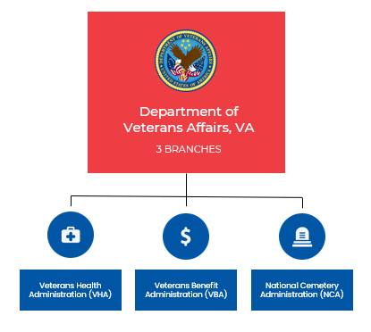
VA
How to utilize
VHA & VBA
Only Veterans are eligible
Must be registered and qualify for VHA health benefits
Services
(including personal care or home care) prescribed by VHA clinician
Veterans and/or their surviving spouse may be eligible
Provide home care hours
VetAssist Program can be utilized in conjunction with hours provided by VHA
Burial expense for the Veteran and for the Spouse
Headstone
The flag

Slide 10
Why Partner
With Us?
We are monitoring and ensuring client compliance
We assist the families to collect all necessary documents
We provide funding for ALL of our clients
We have our own VetAssist app for smart phones and tablets – Easy way to submit referrals
SmartCompanion– 24/7 Emergency Response system with Alexa (video) technology

Slide 11
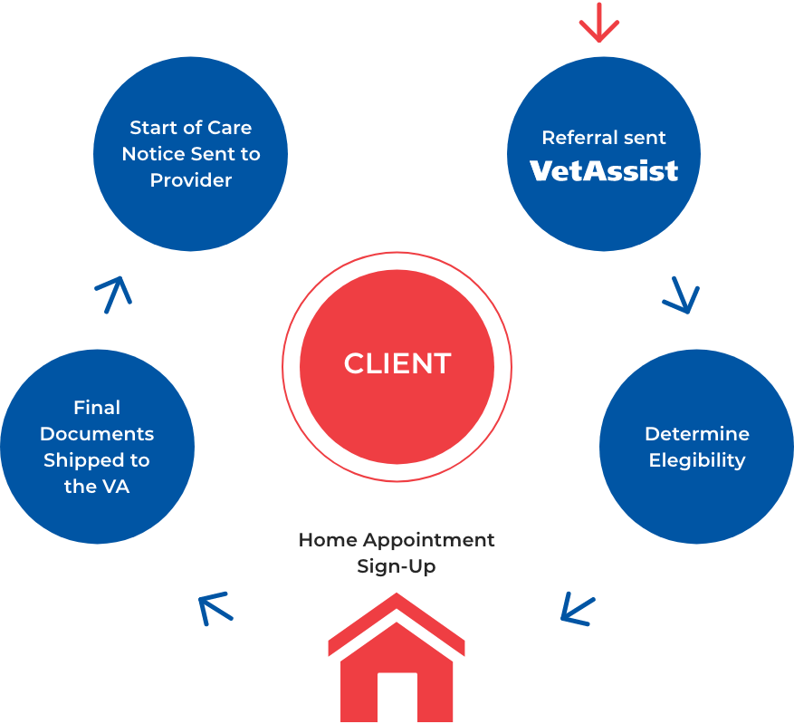
VetAssist Care Cycle
Eligibility

Slide 12
Tools

Slide 13
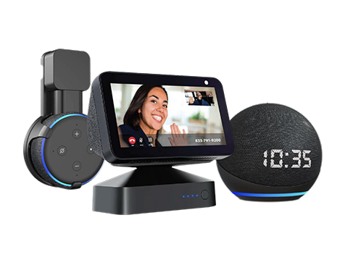
Companion
Service
3 Solutions
For a Safe & Independent Life
24/7 Medical Alert System
Set up Reminders – medication, check the stove, lock the doors, appointments, birthday, check news, jokes, games
Reduce isolation and loneliness - engagement

Slide 14
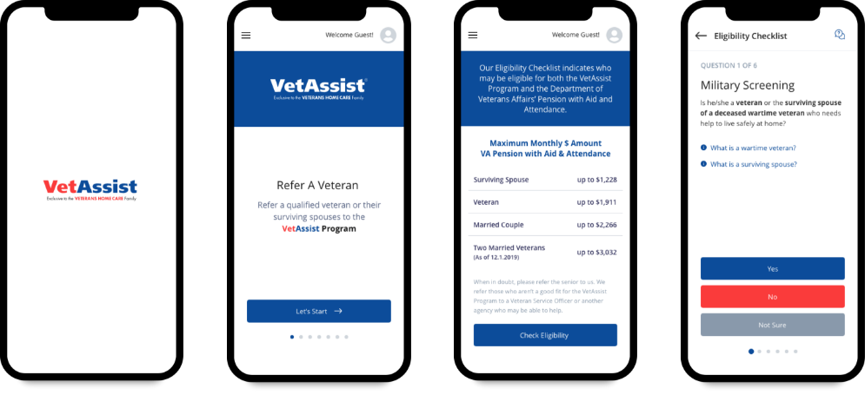
VetAssist
App
Easy to Use Digital Tools
to Quickly Check Eligibility and Refer
Veterans in Need!
With Multiple Options, Referring Clients is Simple!

Slide 15
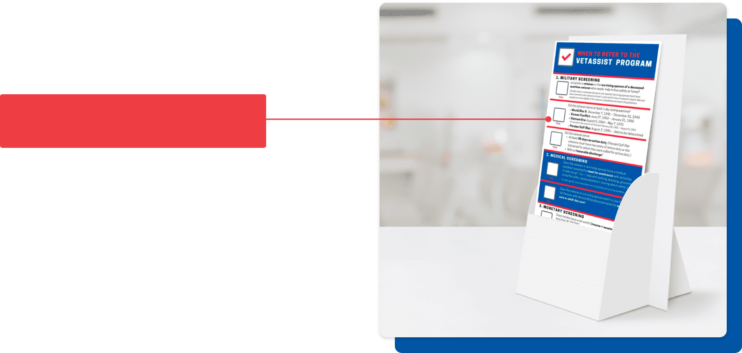
VetAssist Rack Card
Wartime Dates

Slide 16
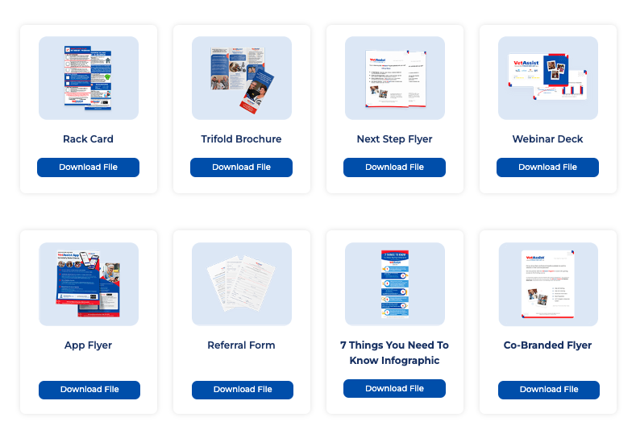
VetAssist Program brand assets at your fingertips!

Slide 17
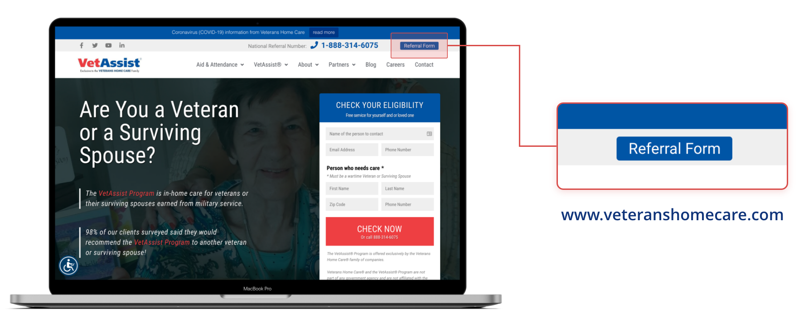
Veterans Home Care Website - Referral Form Tab

Slide 18
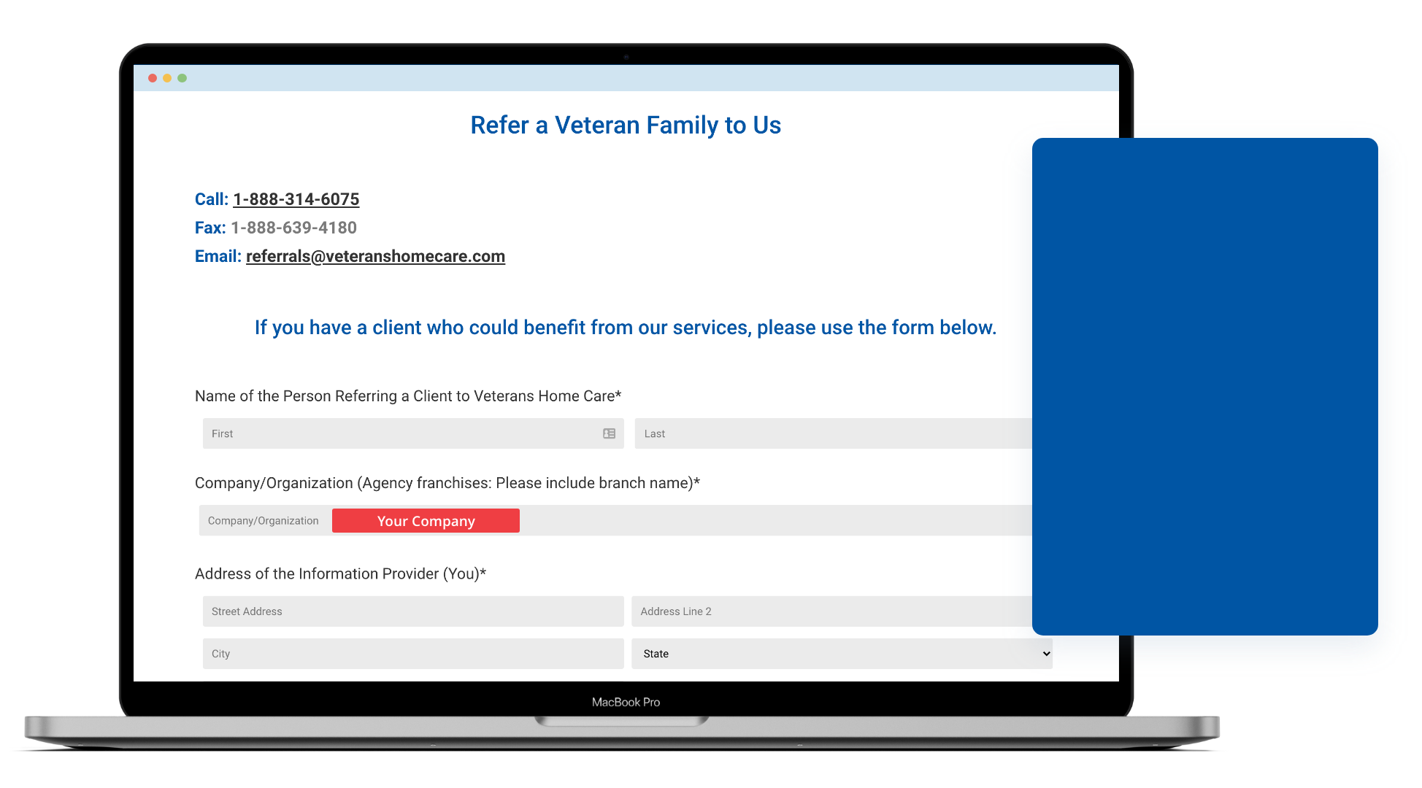
Fill out the
Form on-line
Wartime Dates
Be sure to put
the branch

Slide 19
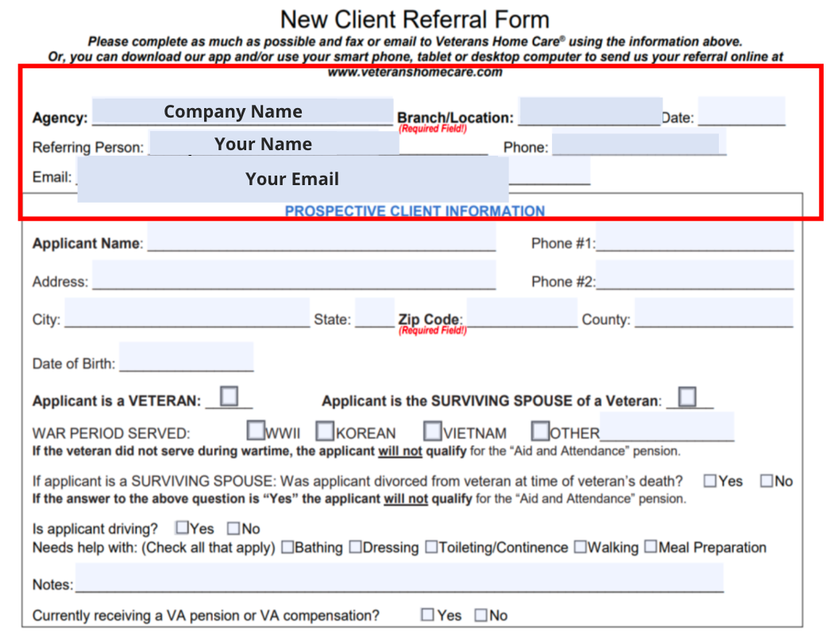
Client Referral Form
REFERRAL FORM
Agency Name
Agency Branch/Location
Referring Person
Referring Person Email/Phone

Slide 20
Enrollment
Specialists
Standing by to take your calls
First impression of Veterans Home Care
Determine eligibility for the VetAssist Program® using our exclusive Lead Tool
If not eligible – suggest other resources
You have come to the right place …
If eligible – the lead tool will capture the information as a qualified lead
We can simplify a complex program …
Once file is ready to ship to the VA, you will be contacted with a start of care notice
We thank you for your service to our country ...

Slide 21
What can you Expect?
WHAT CAN YOU EXPECT?
Qualified team of client support specialists
A partner you can trust to deliver
Client retention that exceeds private pay
Tools and Technology to enhance caregiving

Slide 22
Questions?

